Slide 1
My top existential dreads
-Lupus

Slide 2
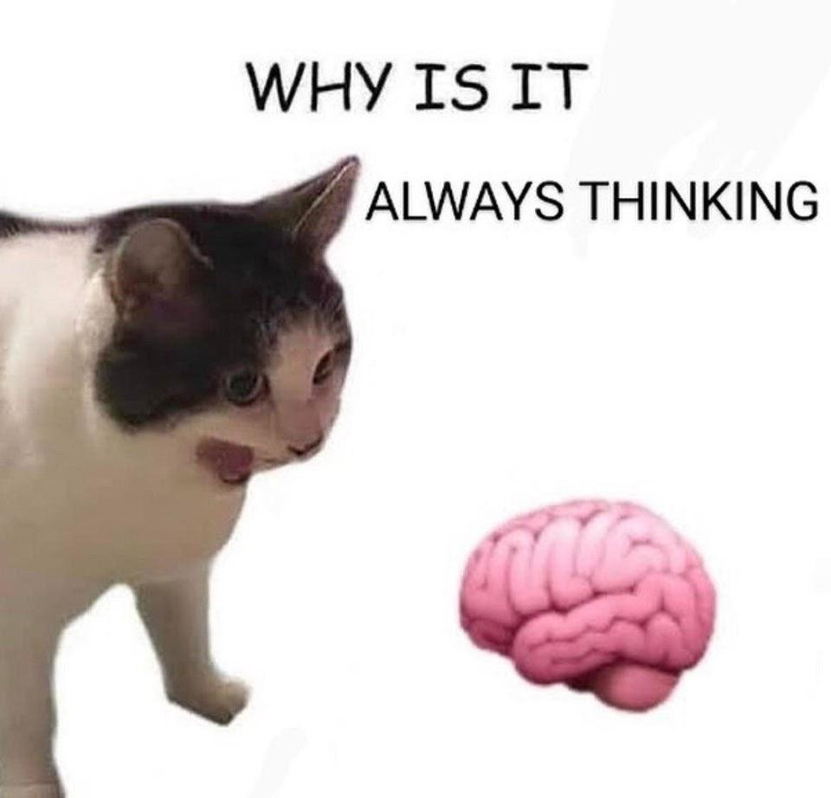
I will split the topic in two sections
Impersonal
I shall rate the pro-s and cons for each one
I will provide some context
Personal
Some wider dreads some more personal
Will give more perspective on my depressos and some ideas related to them
Don’t take this too seriously, feel free to mute me if needed.

Slide 3
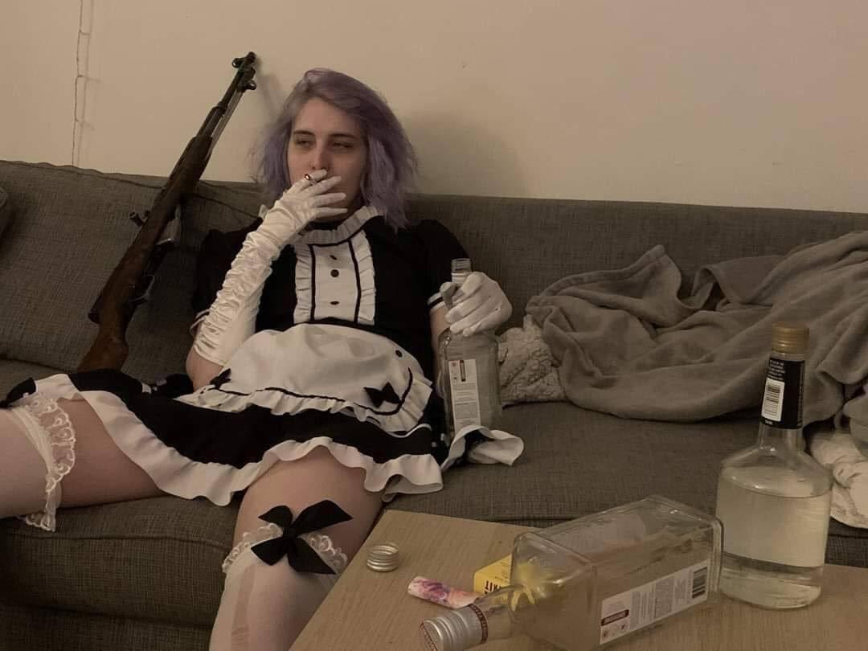
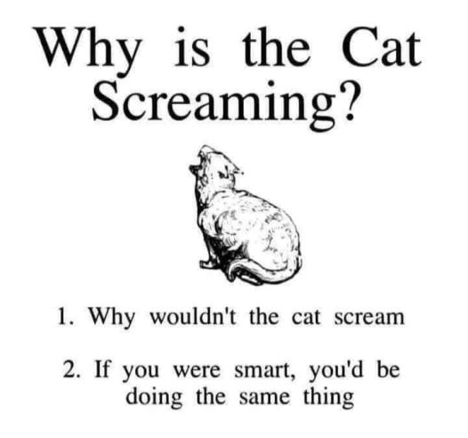
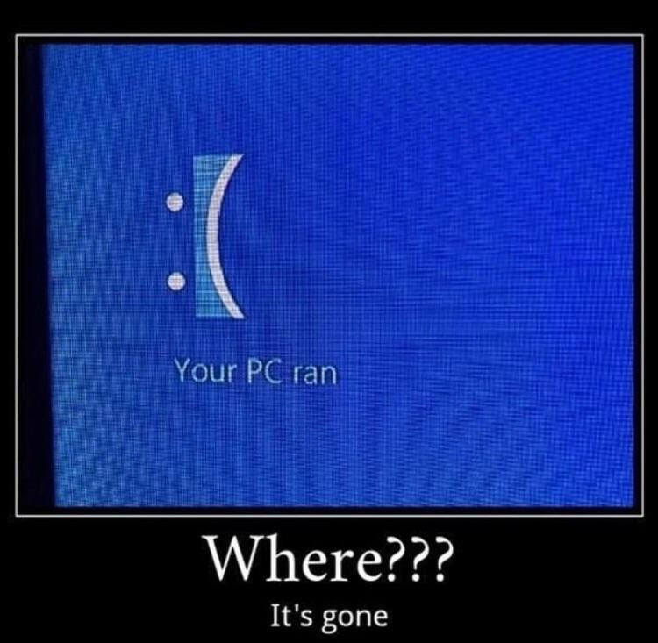
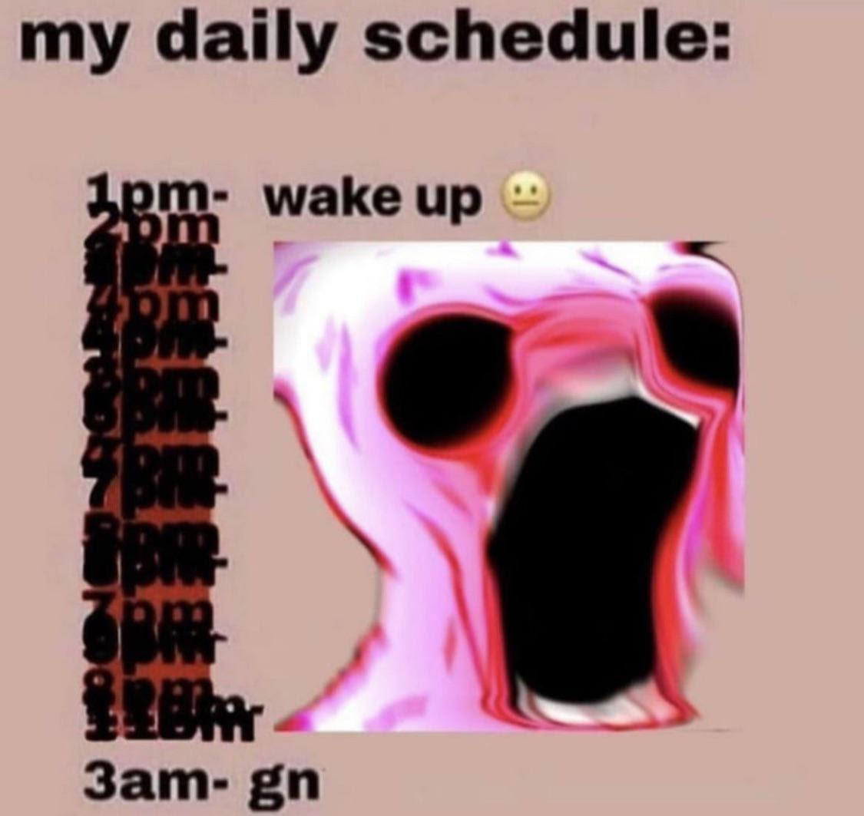
Everything will end
Pros:
A classic
Inevitable
A common idea
Makes all else meaningless
Affects everyone and everything they care about
Cons:
Overused
Distant
You can’t experience non existence
Things and people and life exists now and will do so for a long time.
Learning this can make people grow strong enough to accept loss as a part of life

Slide 4
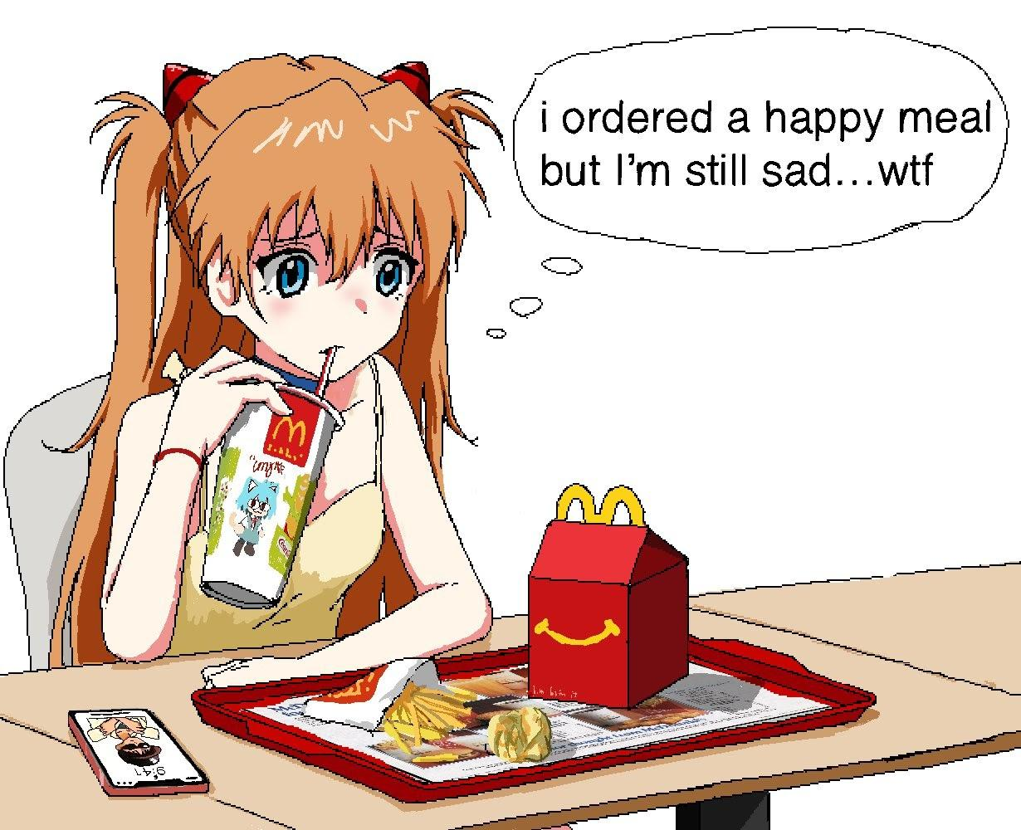
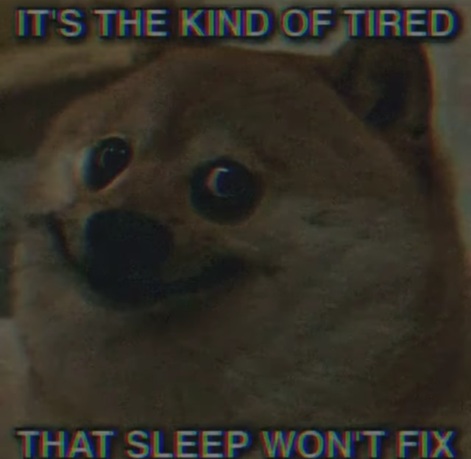
Everything is meaningless
Pros:
Being lost and disorientated
Deep pit that gets deeper the more you dig.
Leads to inaction
Can justify selfish urges or even pure destructive urges
Cons:
Can lead people to find value within the human experience, not anything external.
Will make meaning found later even more profound
Stereotyped as emo and edgy
If the world is just things then what is there for me to do, to be, what even is there but these fleshy robots like me. What do I do with my existence, except for suffering?
One always suffers.

Slide 5
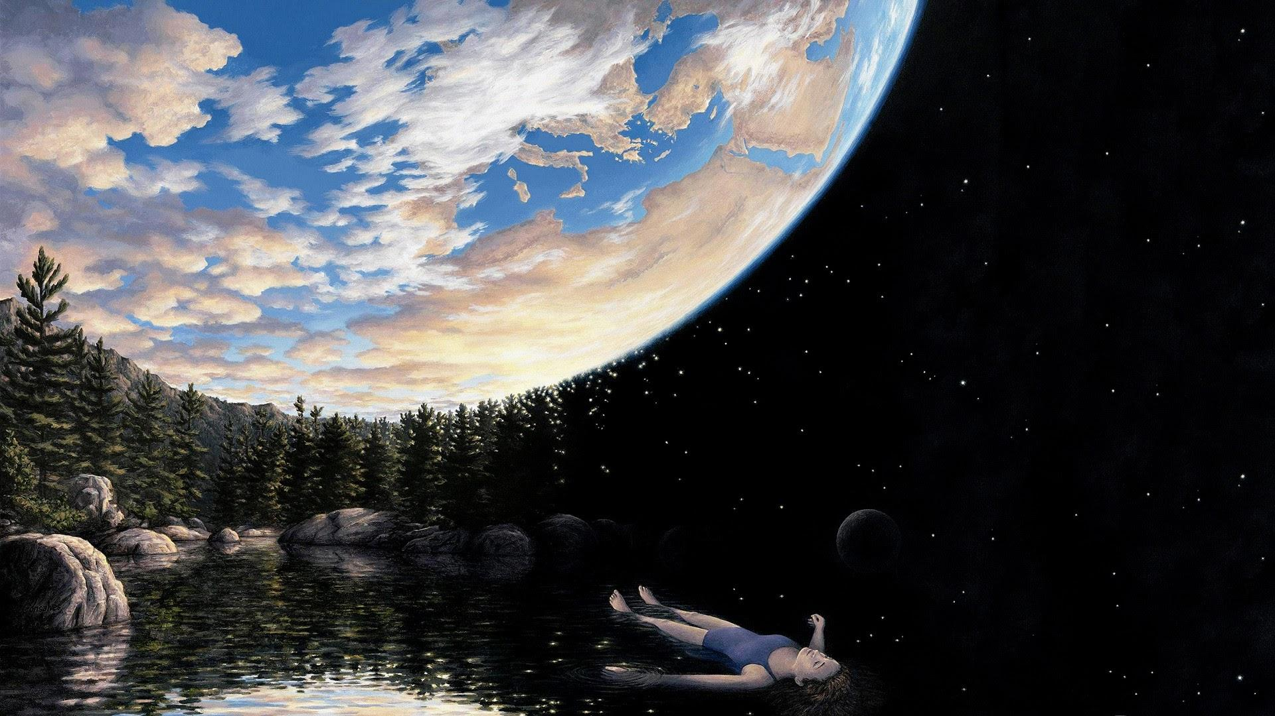
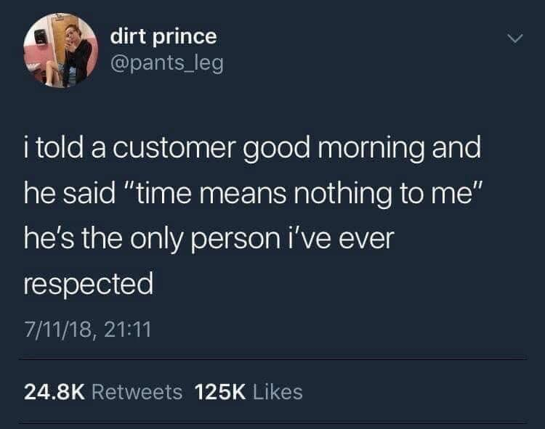
The Cosmic insignificance of your life in particular
Pros:
You are 1/7900000000 of the people only now alive.
The tides of time will wash all mention of your name
The average person accomplishes nothing awe inspiring within their lifetime
Your existence won’t even be noticed.
Cons:
You deeply matter to some people.
Fulfillment, as all other feelings comes only from within.
Every person has the kindling to be superhuman, to lift themselves and others out of hell.
Even without grande importance in the large scheme of things, you are the focal point of your story, your own adventure.

Slide 6

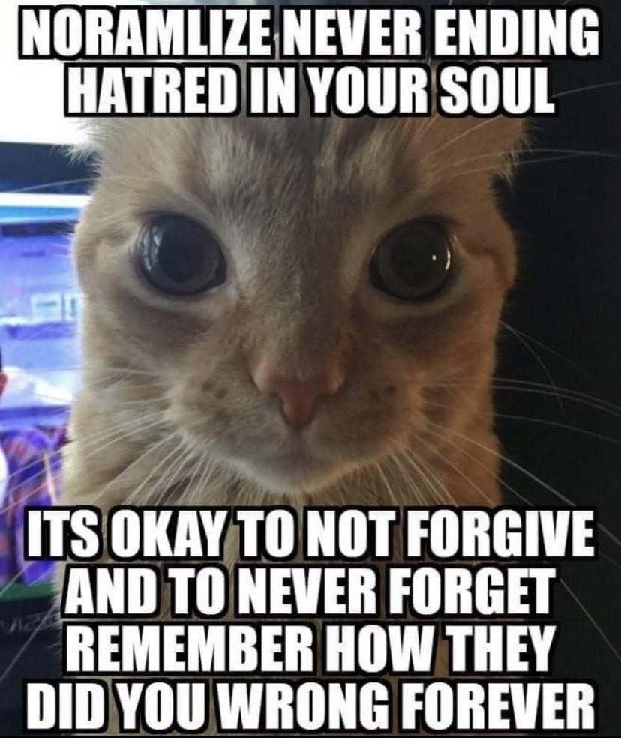
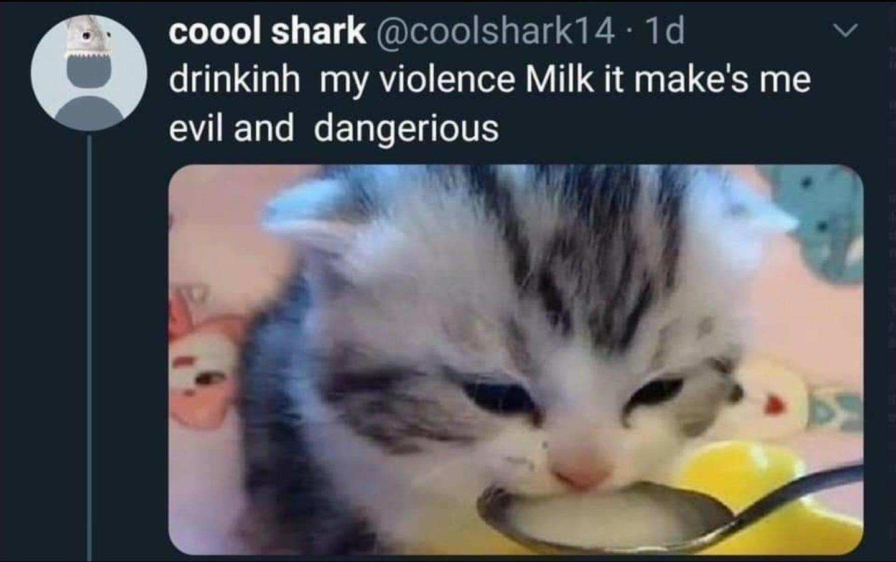
Pros:
Depression
Hate towards the world
The Everything should just end compex
Hate of existence, yourself and making things worse just to spite the world.
Evil can be hard to recognize
Cons:
There exists good as well
One cannot choose the world they’re born into, only how they act.
Seeing cruelty can make a person stronger and more resolute in trying to do good.
The problem of evil
There is evil within the world There is evil within yourself
If there is a god, he’s made such suffering unfairly. If there is not, we live in a world doomed to suffer, truly to exist is to suffer.
Is a world so full of cruelty, suffering and injustice justified in existing?

Slide 7

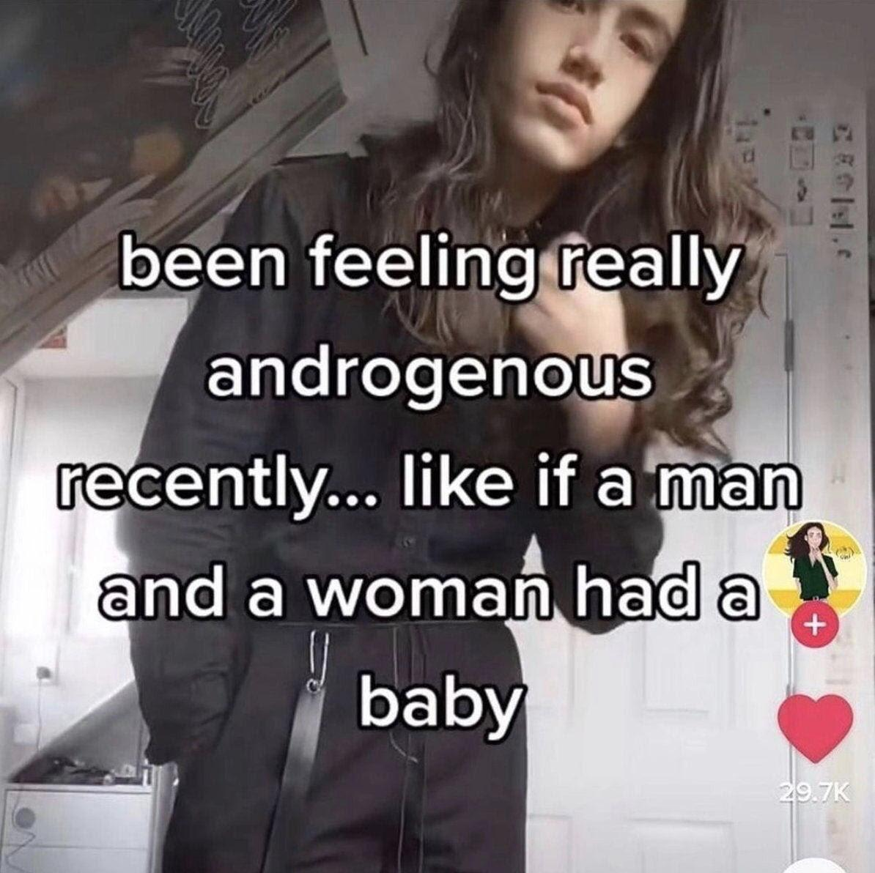
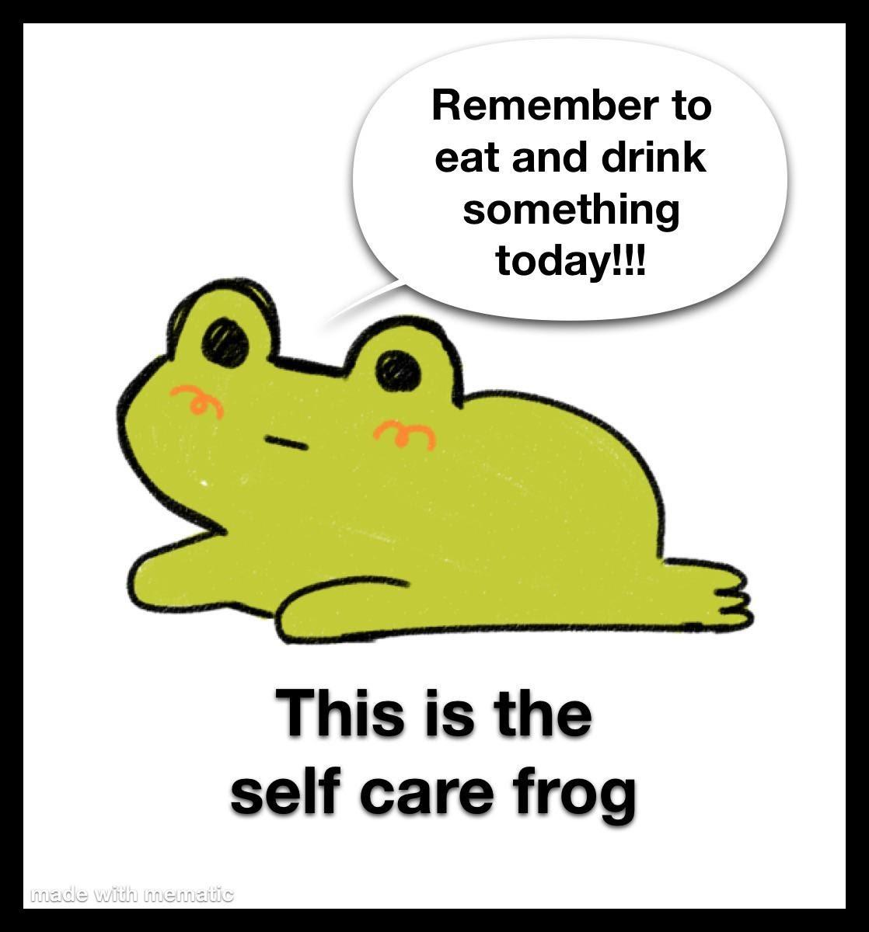
Before we move on to my dreads
How is everyone doing? Does anyone need to say something or take a break. This next part can be a bit much.

Slide 8
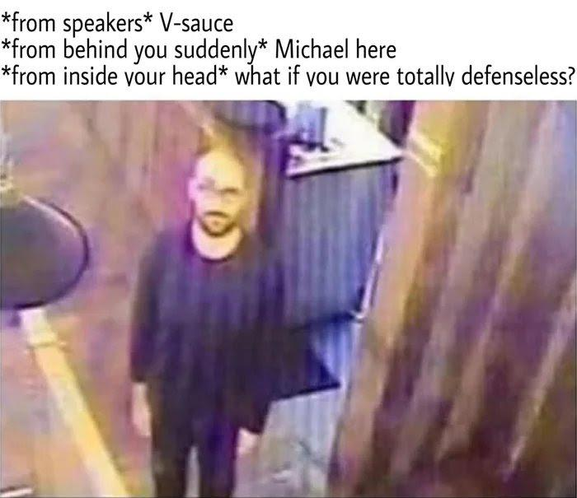
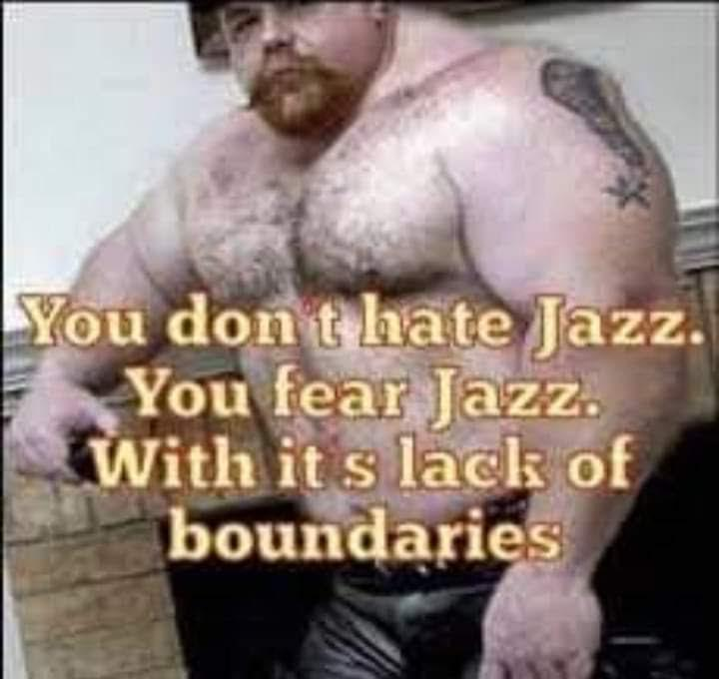
The impossibility of navigating a complex world
There are more things in heaven and earth, Horatio, Than are dreamt of in your philosophy.
Pros:
Paralyzing uselessness
Feeling of no control
Makes one tiny and insignificant, sometimes wanting to crawl under a rock and rot there
Cons:
Needs to be thought through to realize
Can lead one to grow cautious and wise to their own lack of knowledge and leave them tempered with humility
Can be lessened by realising you needn’t know everything, only do your best to make the right decisions.

Slide 9
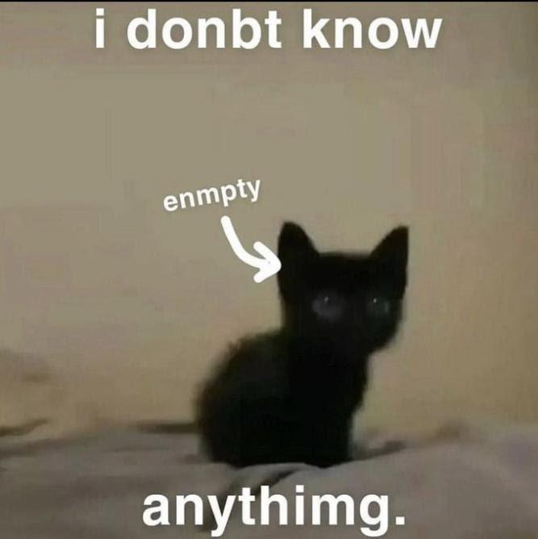
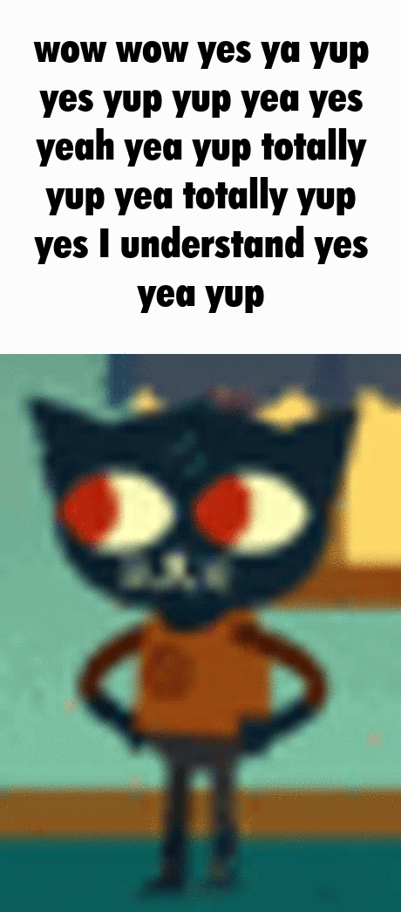
I don’t know anything and never will
I know how surface level I know topics
I’ve never learned how to learn
I fear finding out i’m ignorant and stupid
I will never be able to match the greats of past

Slide 10
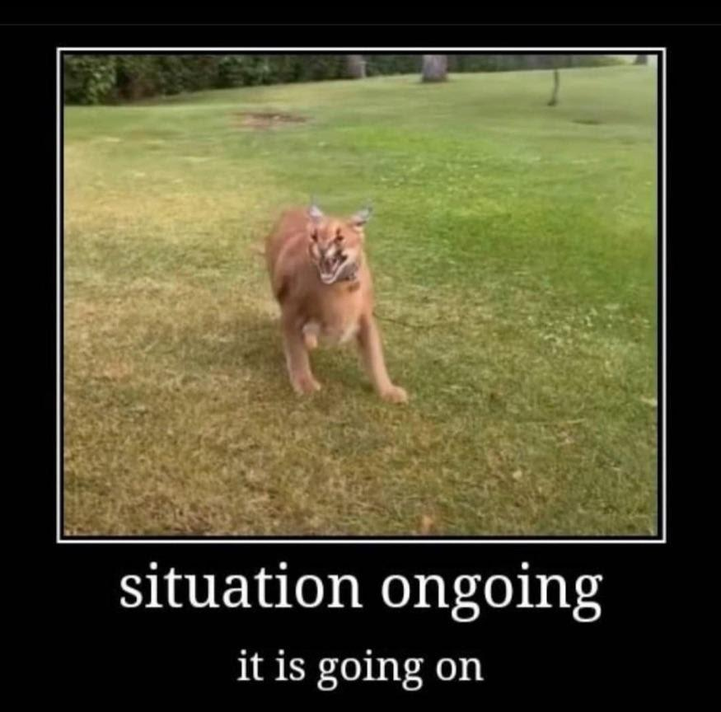
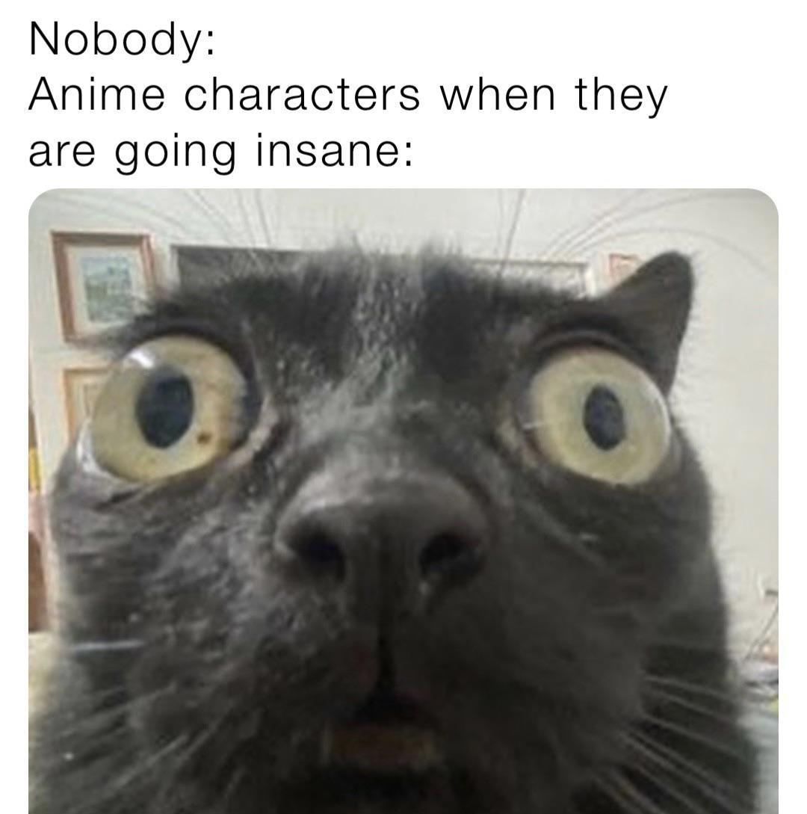
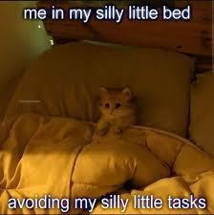
Being in a shitty situation is unavoidable, here’s mine
Grandparents health:
Grandad has cancer
Stage 4 lung and kidney
Very likely going to die soon
Grandma, great grandma and grandad are basically all alone if i can’t go to them
Have to keep my distance cause of corona
Military:
Increasingly lessenging time for my own things
Cannot even spend much time w my grandparents.
Feeling incompetent:
I feel I know nothing of the things I want to
I’ve never learned how to push myself
I feel lost within a world of complexity
I feel like i’m horrible at the things I like doing

Slide 11
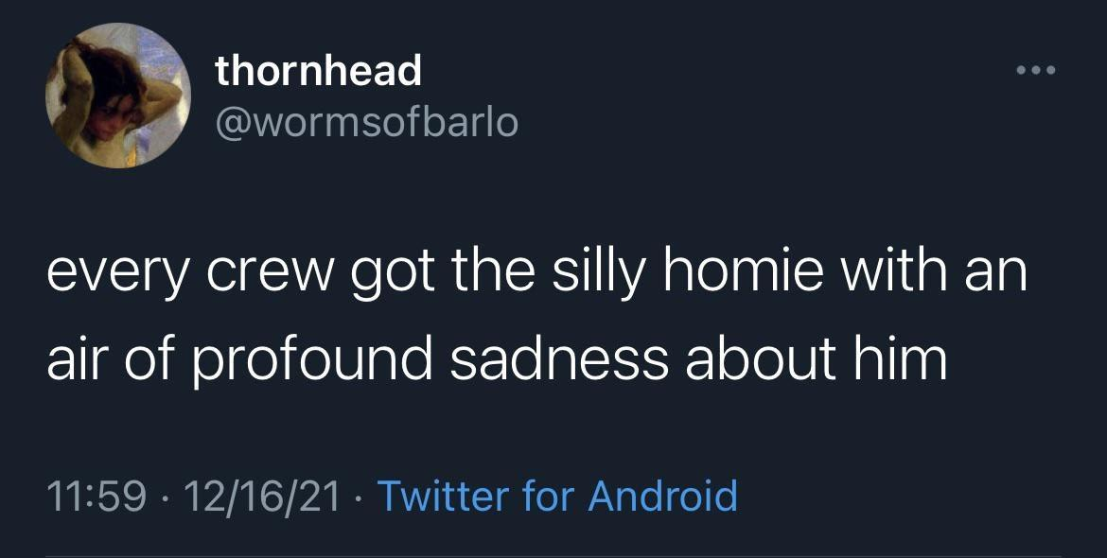
What to do with all this?
Is there anything we can do?

Slide 12
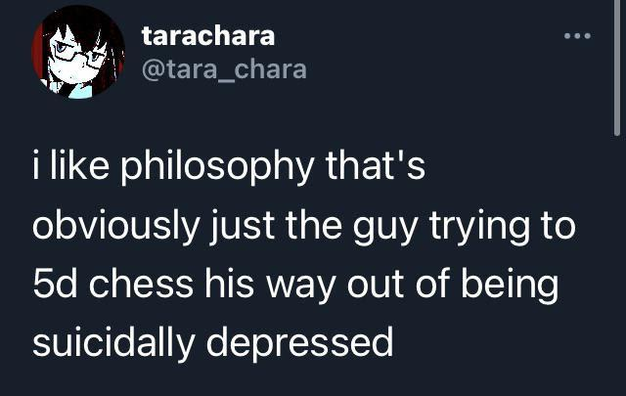
There are things that can help
These are timeless ideas, as such they’ve been tackled before

Slide 13
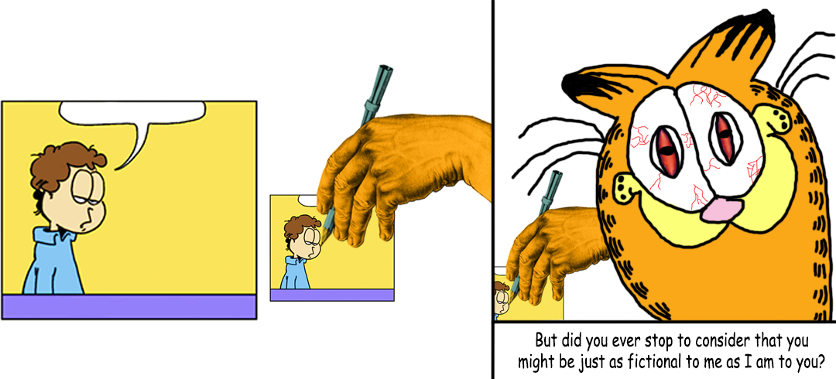
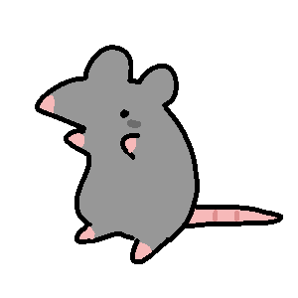

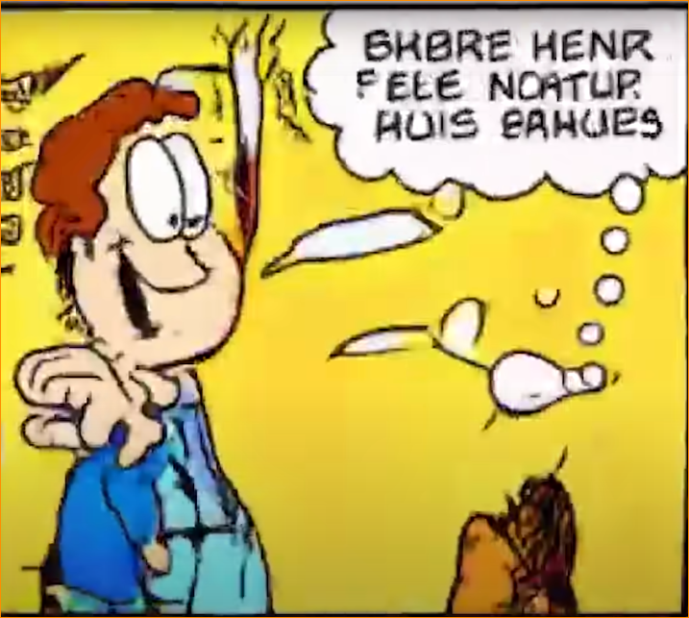
To live is to suffer
Death comes from life, Life comes from death. From within your fears comes the strength to overcome them, to grow and overcome maleficence.
If one turns their inner eye truly upon themselves, not turning away in willful blindness they will see everything within. They will see the evils they commit to themself by turning their eyes from what’s uncomfortable within. Seeing your lesser qualities, you will see a shimmer of what you could become if you faced them.
What you could be If you let yourself know what you knew, if you didn’t shut up the higher part of you that gives you grief for knowingly doing the lesser deed. From sight comes wisdom, from following wisdom comes pain, turning from pain comes suffering, from facing pain willingly comes strength. Wisdom and strength make saints.
After all.
Is not life but a stone for Sisyphus to push up the mountain, a heavy load of excruciating effort and pain.
Regardless of how much effort he uses, the boulder will inevitably roll down the mountain all the same, crushing, with the absolute sin of existence. Truly then, why would he bear the burden of it? Why face it and push that boulder, knowing you’ll have to push it up again. Is he not insane who knowing this, not only suffers but pushes on, knowing to be for naught? Is he not a coward? Is it not better to leave the stone where it lay?
Perhaps…
This world is unjust, full of suffering and meaningless.
Perhaps, meaning is found alongside the suffering…
Perhaps he who knows the suffering, pain and injustice of the world, is the one fit to strive forth and redeem himself and a corner of the world
I fear that nothing can stop this, stop the heartache

Slide 14
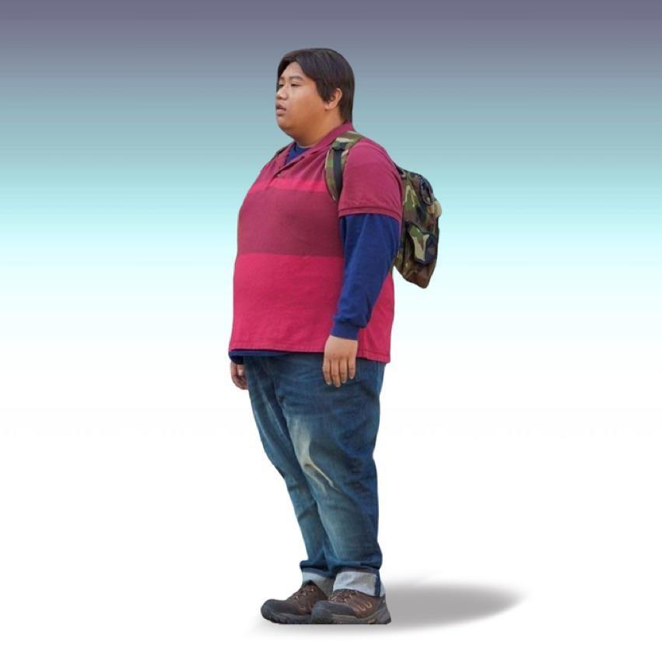
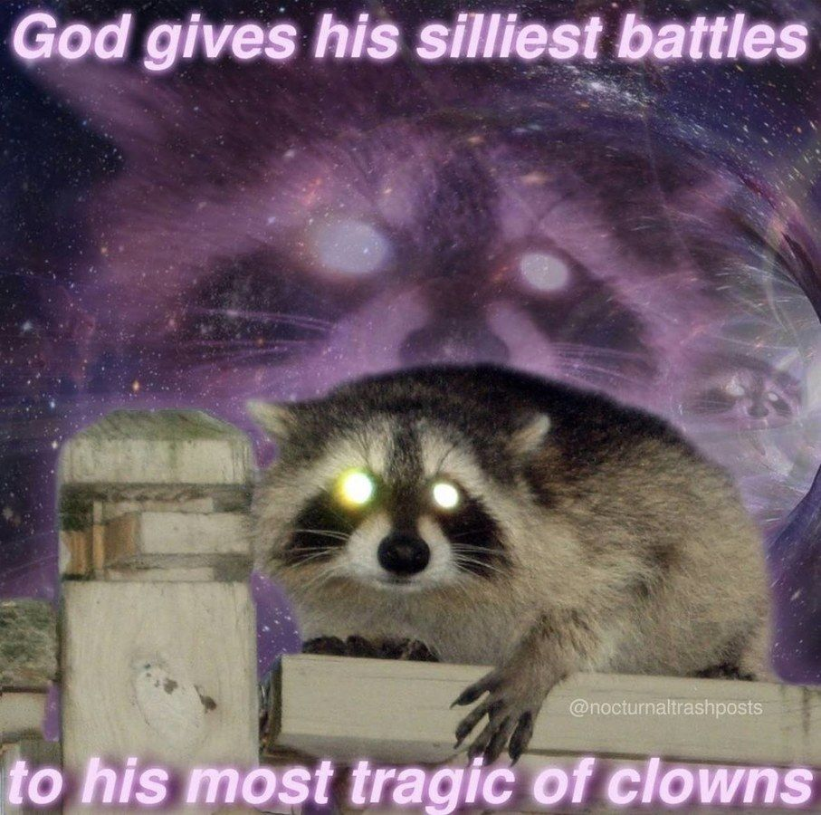
A quote from the inventor of sex
The purpose of life, as far as I can tell… is to find a mode of being that’s so meaningful that the fact that life is suffering is no longer relevant. And if you find it, break what must be broken, once for all, that's all, and take the suffering on oneself.
If I but were like you Alyosha I could forsake suffering as a motive. I would let if fly off with the fluttering wings of songbirds. For what is hell? I maintain that it is the suffering of being unable to love.
At the base of your soul is the conviction that what’s worth pursuing is the good. And that, through kindness and humble insight.

Slide 15
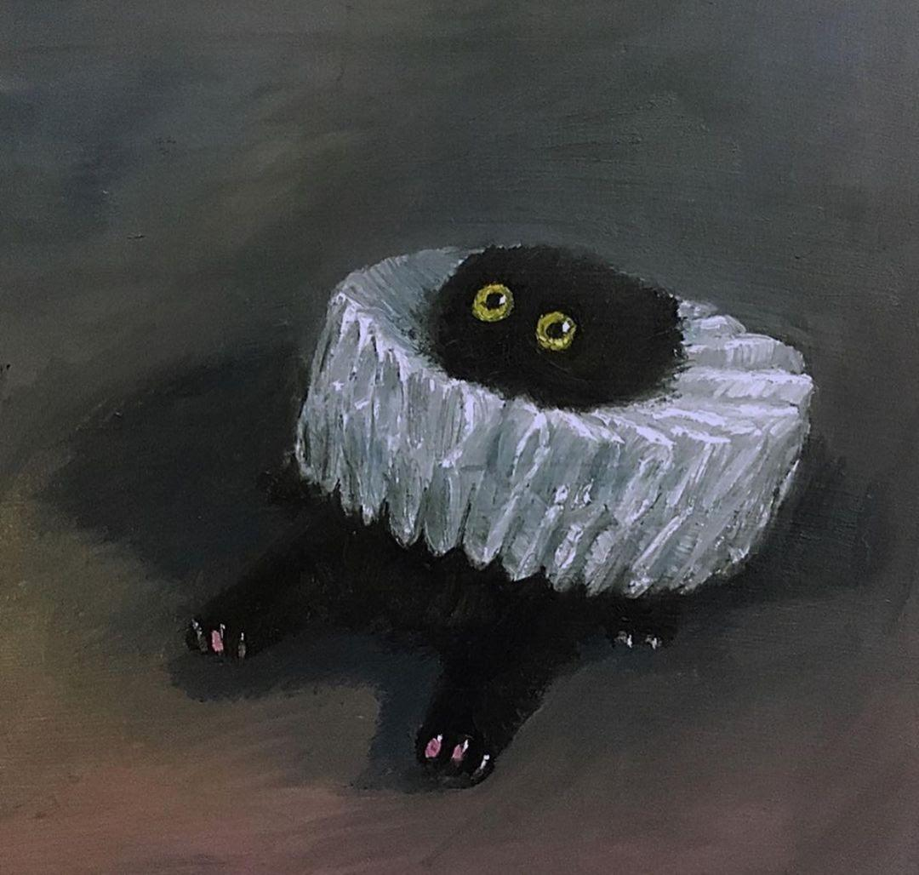
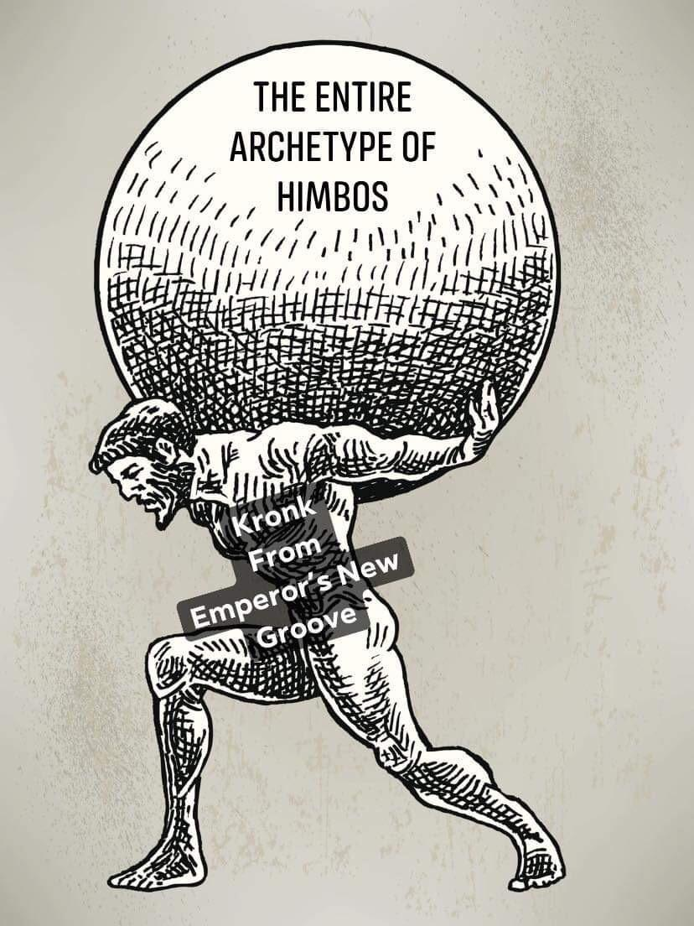
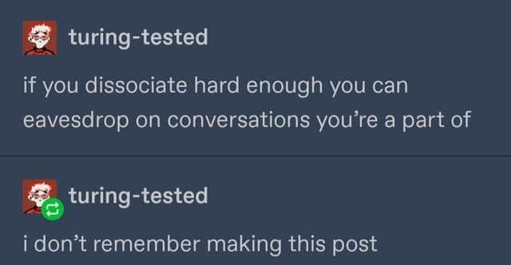
Can you counterbalance the suffering?
Atlas fought against the gods, For this he was burdened with the entire weight of the heavens. Only a truly herculean character could bear it on their back willingly without being crushed. But one cannot be born hercules. They must defeat and subsume the monsters within. Carry just as much as they can handle. Then some more. As one’s eyes open to their own existence, seeing their waking will upon the earth, they awaken to their strength. They, who see all the paths ahead and see where their steps would cause the earth to crumble and swallow them up with selfmade hellfire. Those are they who can step with solid footing against the utter chaos and bring forth a spark of divinity. Not the quiet divine of new-born innocence but howling tempest of those who’ve been through hell and returned to face it. One cannot help but view Atlas with both awe and horror. The burden of the world is one we all shoulder, it is the highest honor as well as the most heavy of burdens. But it needn’t be one shouldered alone, the more people that support the sky, the lighter it gets and the brighter the dawn.

Slide 16
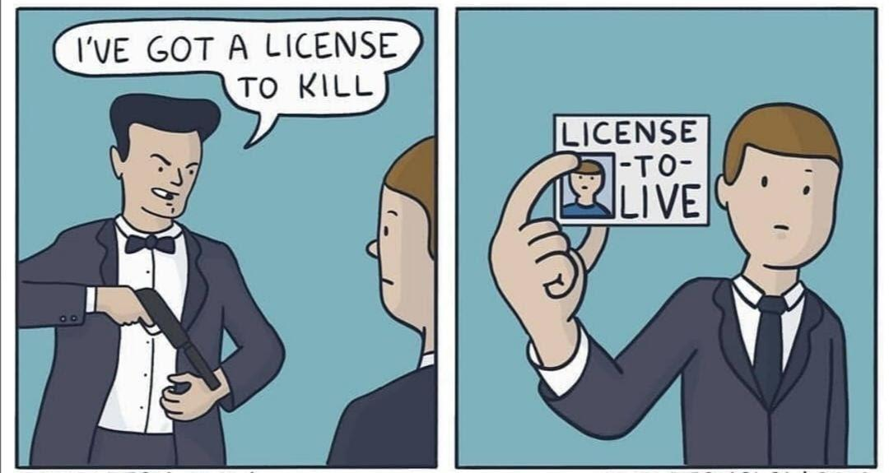
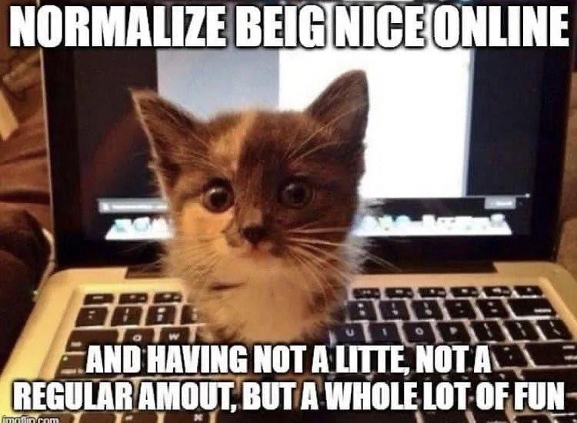
There’s no avoiding suffering and the cruelty within life.
Yet you can still do your best to make life better.
You can recognize the suffering and go on regardless. Life is to be found within finding a path for yourself, one that grows first you and then the world.
An endless love of life and several philosophies
Existential dread

Slide 17
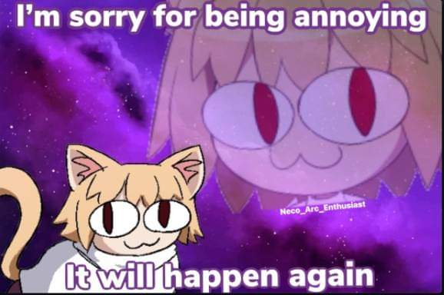
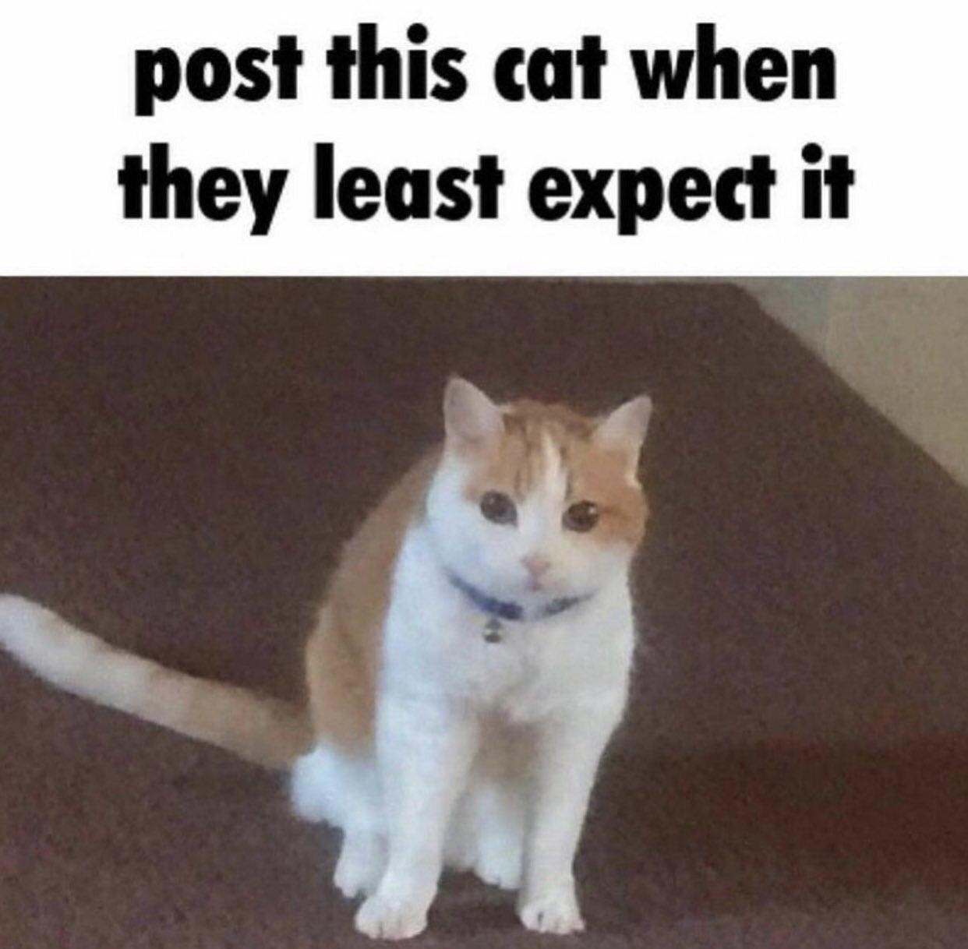
Thanks for listening, any questions?
I hope this rambling wasn’t too horrible to listen to.

Slide 18
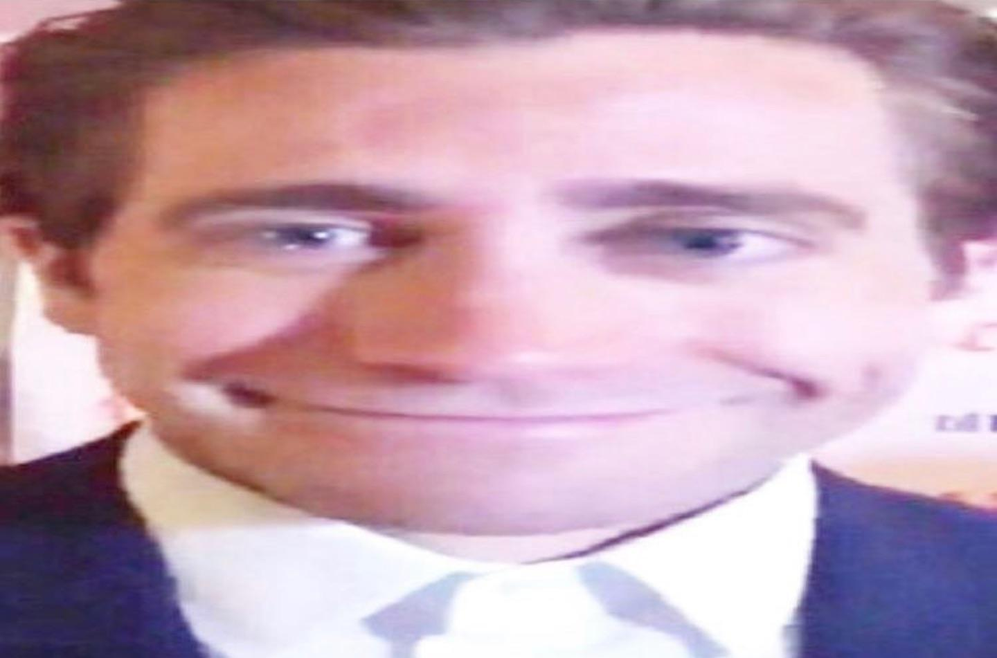
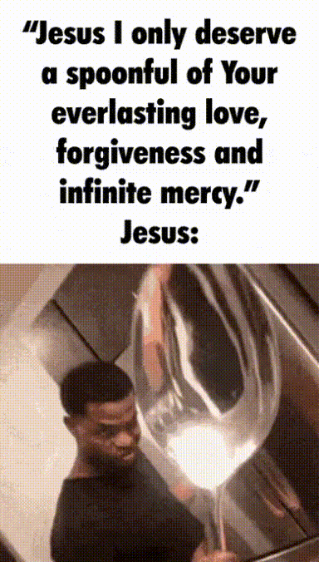
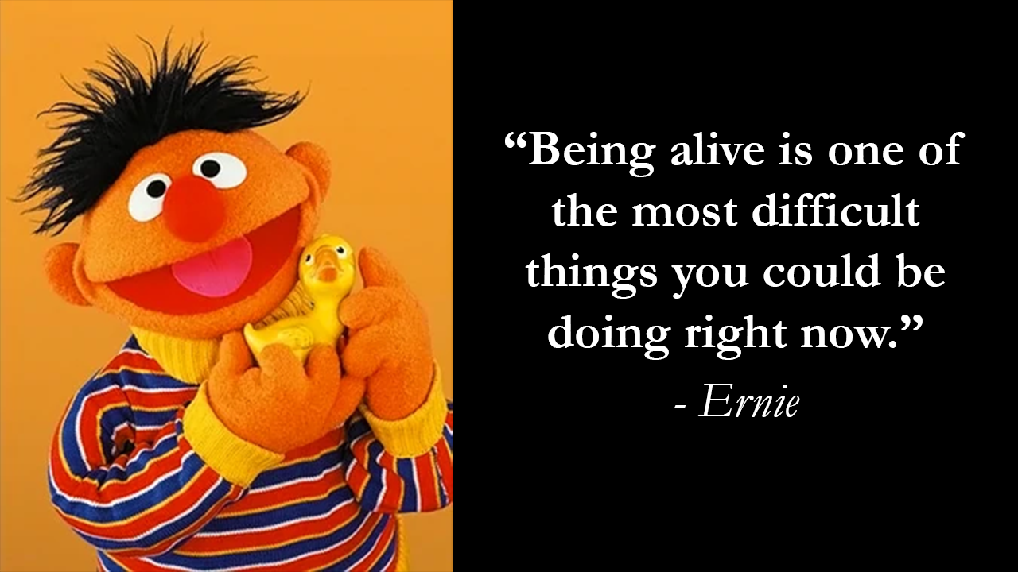
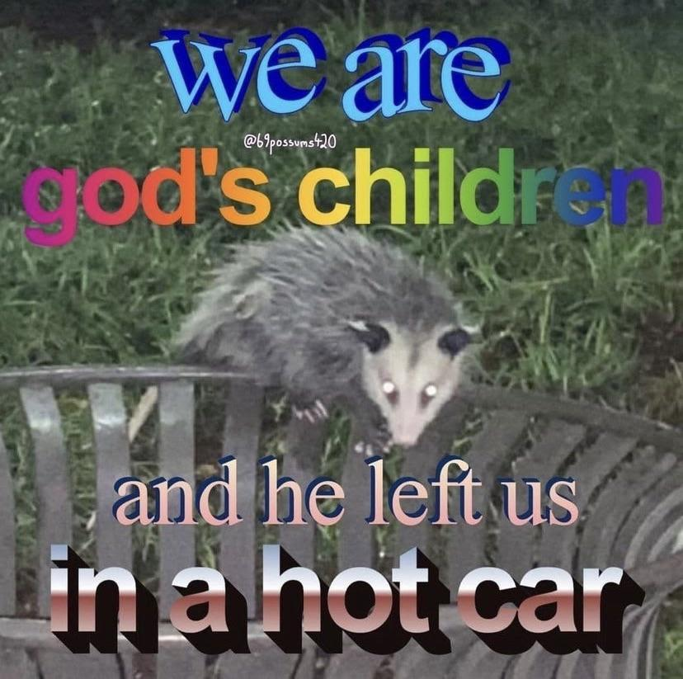
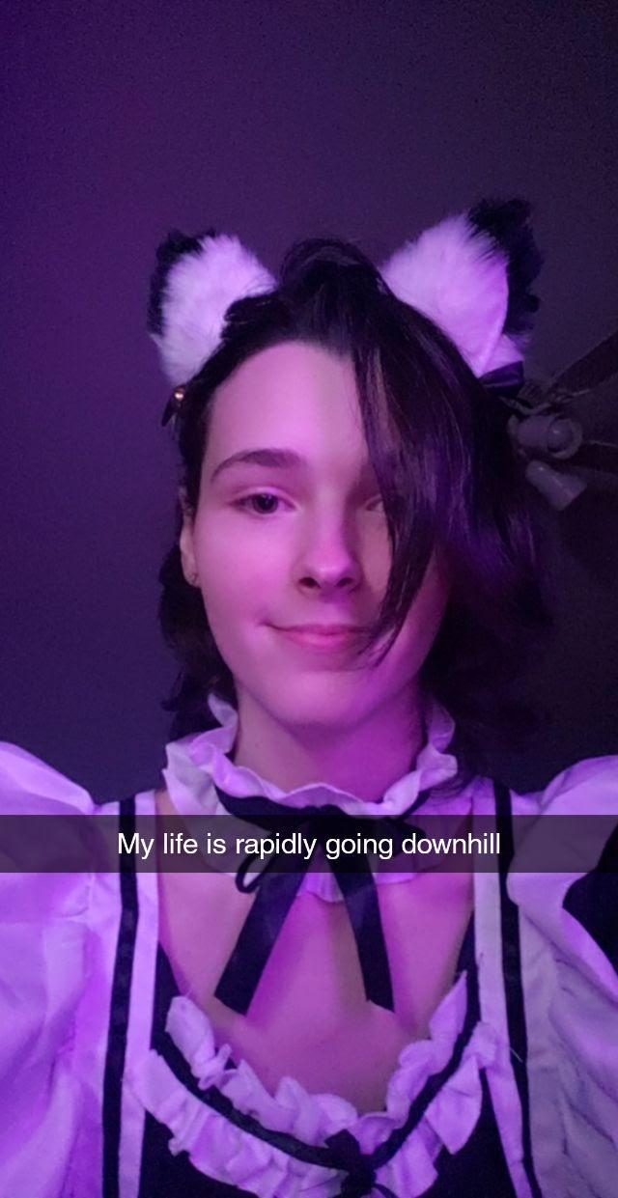
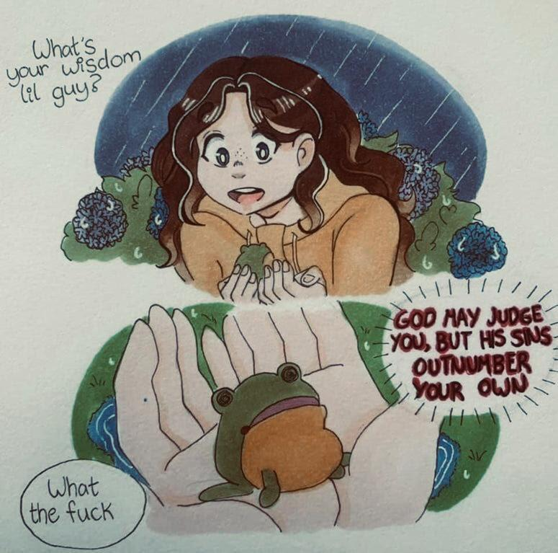
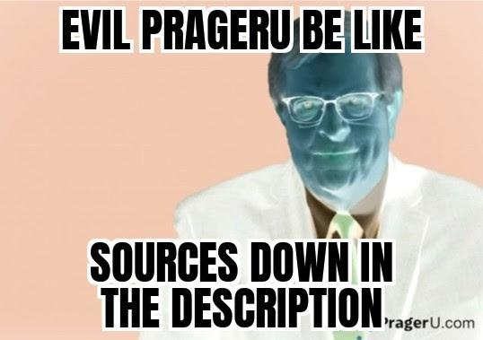
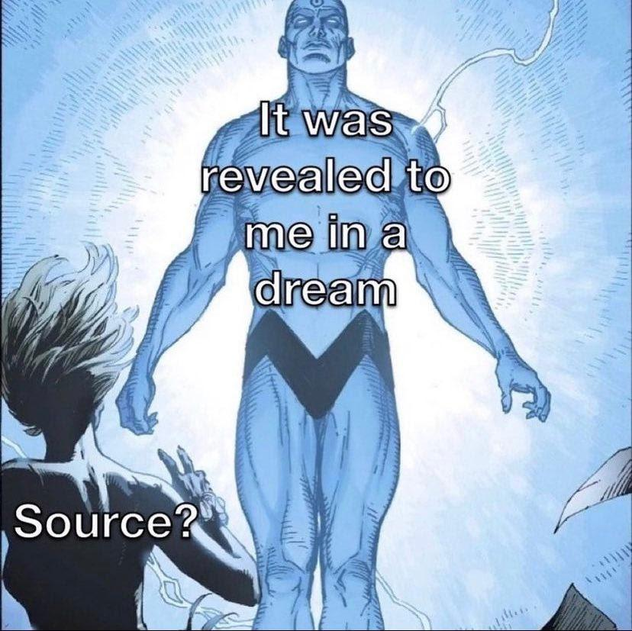
Some good sources to look into
Stoicism - Control over one-self and suffering
J.B.Peterson - what is meaning, also a great guide into the other subjects
Dostoyevsky - The conflict of ideals
Albert Camus - absurdism
David Goggins- overcoming oneself

